Slide 1
Face Detection

Slide 2
Background

Slide 3
Face Detection
Objective
Create a machine learning application to detect faces in real-time using a web camera
Specifications
Use the Cascade Trainer GUI to train Haar Cascade Classifiers to detect faces.
Use Python to program the trained Haar Cascade Classifiers to detect faces using a web camera

Slide 4
Haar-like features
Haar-like features
Machine learning based object detection algorithm
Detects objects with certain features in images and videos
Positive dataset contains images with such features and negative dataset without them
Features are organized in a layout called Haar Cascade Classifiers and saved as .XML

Slide 5
Face Detection
Positive Dataset: Human Faces
Created by Ashwin Gupta
Utilizes data from a mix of all common religions, races, and age groups
Utilizes datasets generated through Generative Adversarial Networks (GAN)
Link to dataset: https://www.kaggle.com/datasets/ashwingupta3012/human-faces
Negative Dataset: Background images
Extracted from GitHub (https://github.com/handaga/tutorial-haartraining/)
Utilizes data from UMD Background Database and other resources

Slide 6



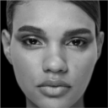
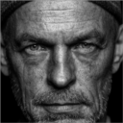



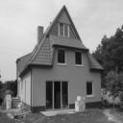

Datasets
Positive Datasets
Requires cropping to show faces only
May reduce the size for faster data training
Negative Datasets
Does not require cropping
May reduce size for faster training
Can be any image that does not have faces

Slide 7
Cascade Trainer GUI

Slide 8
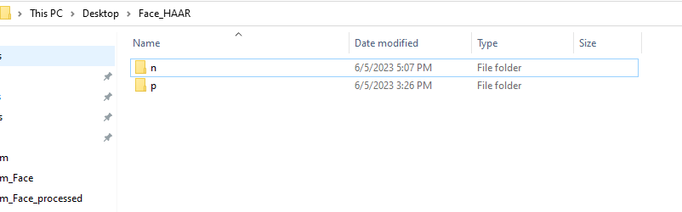
Cascade Trainer GUI
Cascade Trainer GUI simplifies training Haar Cascade Classifiers
Positive images and negative images should be kept in p and n folders respectively

Slide 9
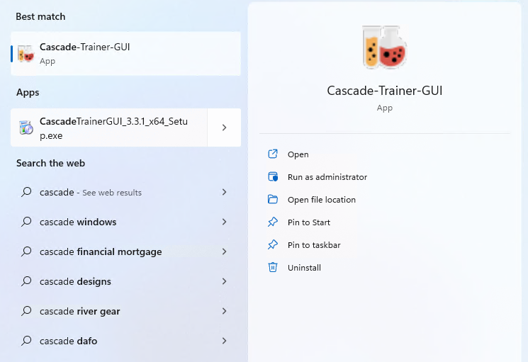
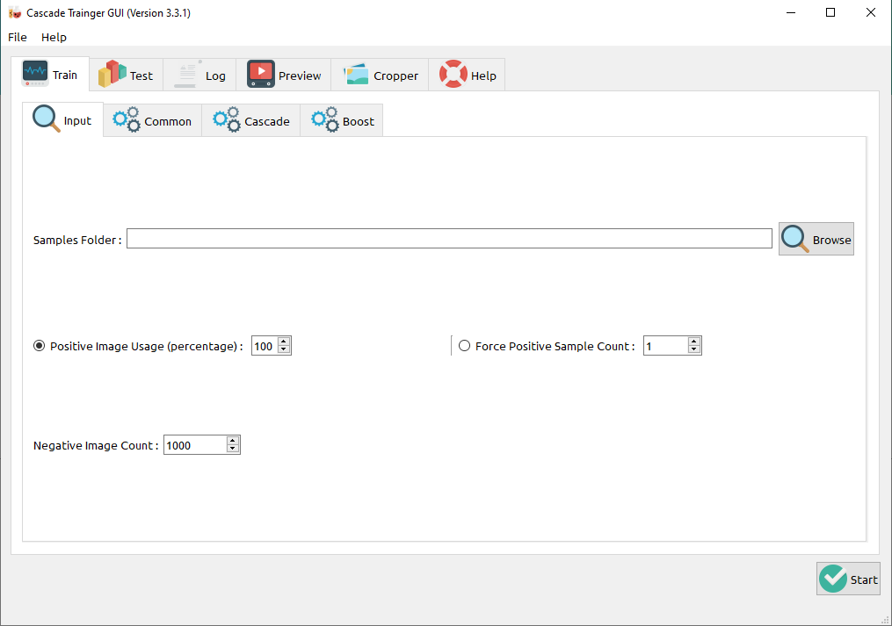
Cascade Trainer GUI
Open the Cascade Trainer GUI app
Once the app is open, browse the directory

Slide 10
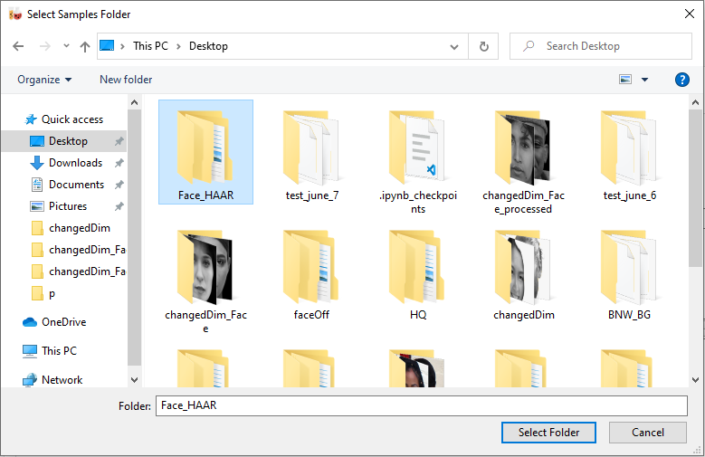
Cascade Trainer GUI
Select the directory that has p and n folders
Select your directory
After selecting the directory, click on Select Folder

Slide 11
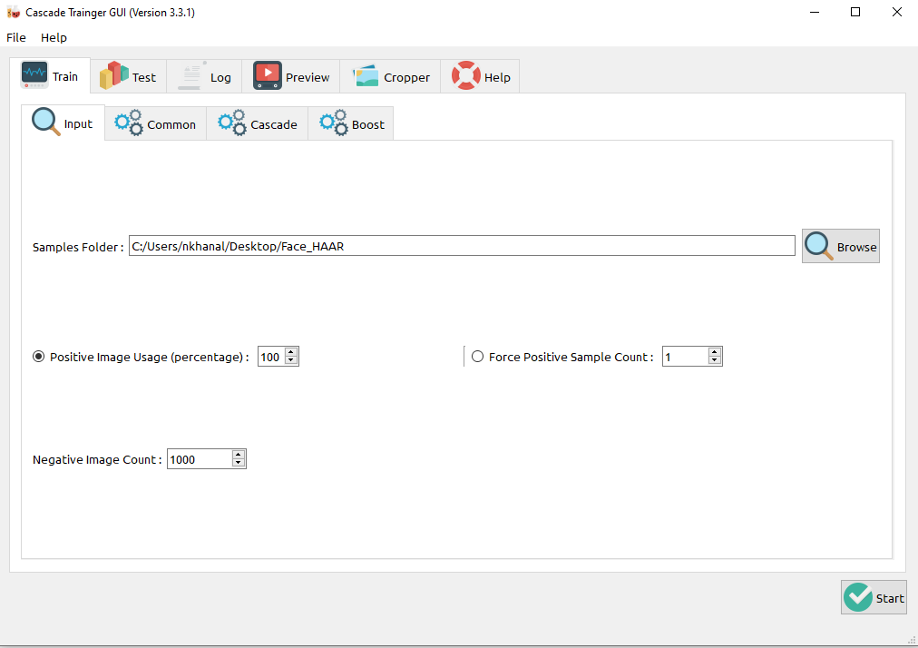
Cascade Trainer GUI
Set the positive image usage (percentage) to 88%
Set the negative image count to 900
This will let us use 88% of positive data and 900 negative data for testing
Set to 88
Set to 900

Slide 12
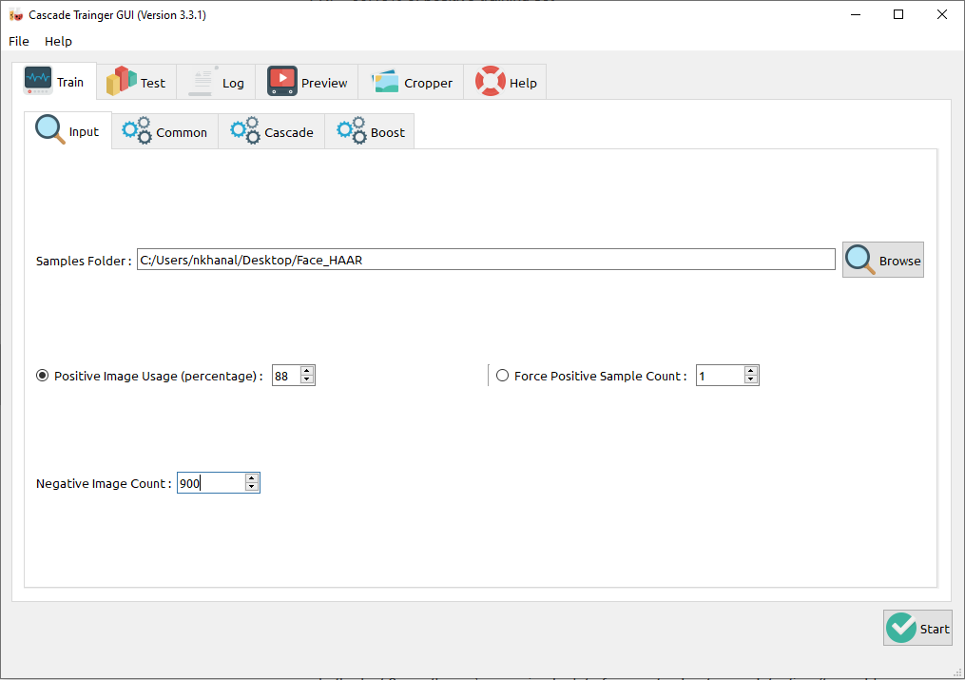
Cascade Trainer GUI
Finally, click “Start” to train the images
Click here

Slide 13
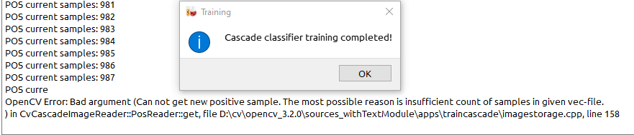
Training Process
Typically, the training dataset with less than 2000 images requires an hour to train.
If you encounter issues or errors while training such as:
Refer to Debug slider for fixing such errors

Slide 14
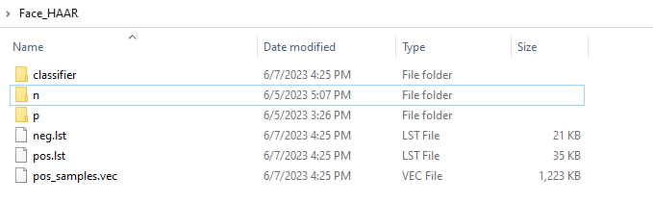
Trained Cascade Classifier
If training completes with no errors, there will be a new folder in your dataset folder
There will be a new folder called “classifier” that will have the trained .XML file.

Slide 15
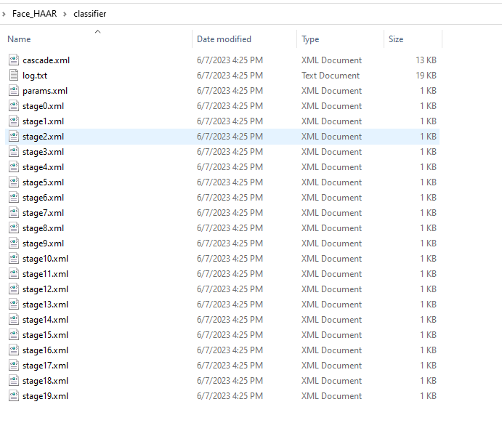
Trained Cascade Classifier
Inside the folder, there will be various .XML files.
cascade.xml is our trained xml file for face detection. The params and stage xml files can be ignored.

Slide 16
Detecting Faces

Slide 17
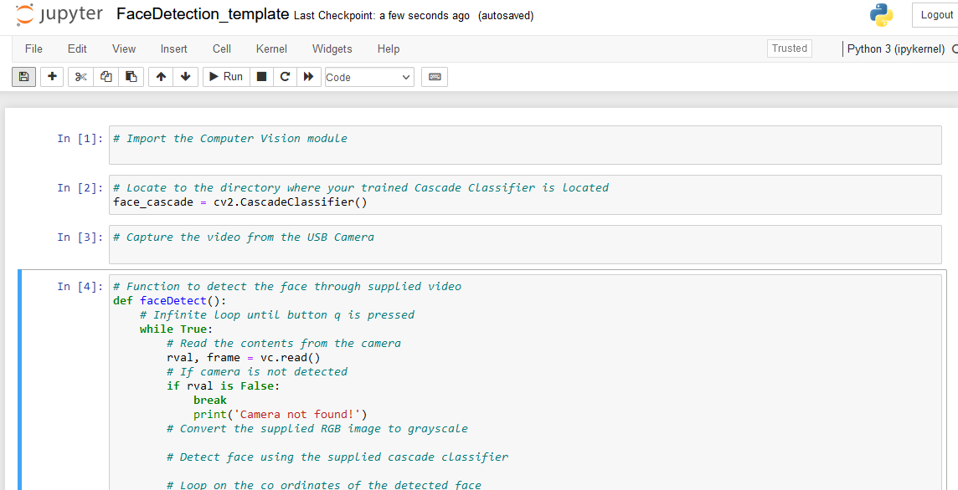
Jupyter Notebook
Open Jupyter Notebook
Load FaceDetection_template.ipynb file

Slide 18
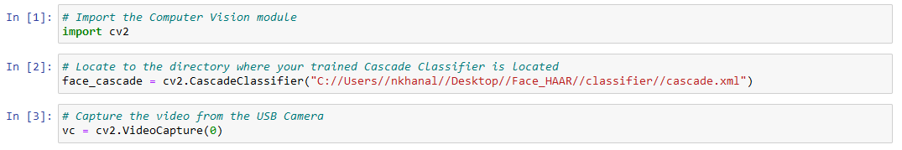
Code
Add your trained data location
Refer to the next slide for finding the trained data location

Slide 19
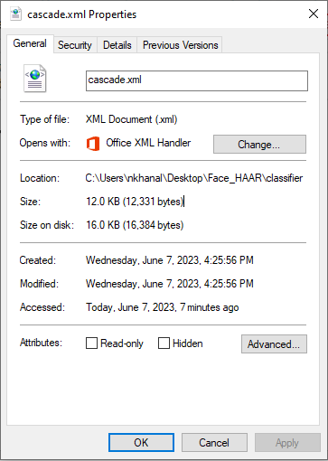
Trained Data Location
Right click on cascade.xml and select properties
Change backslash to double forward-slash and add //cascade.xml
Copy the location
Final location should be similar to below layout
C:\Users\nkhanal\Desktop\Face_HAAR\classifier
C://Users//nkhanal//Desktop//Face_HAAR//classifier//cascade.xml

Slide 20
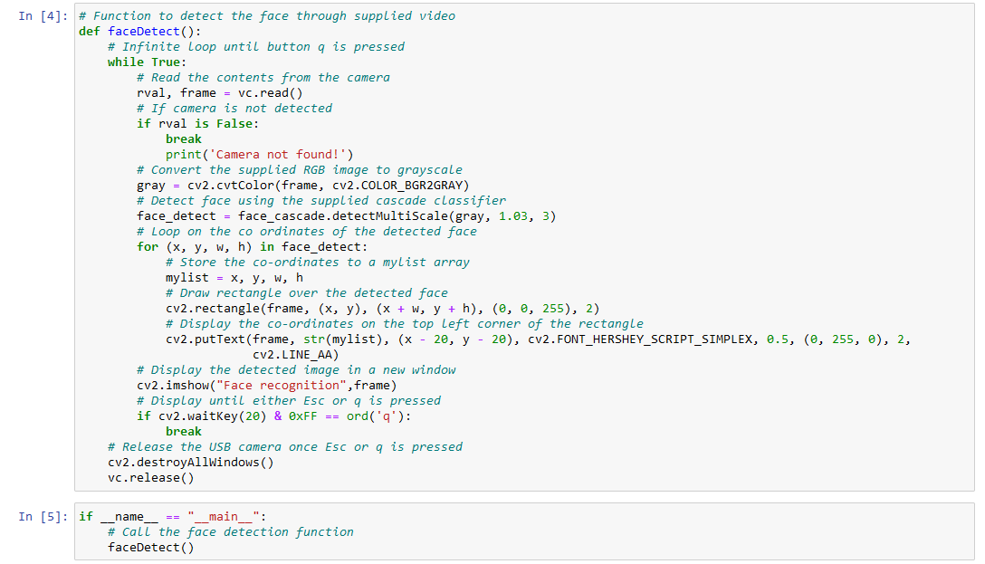
Code

Slide 21
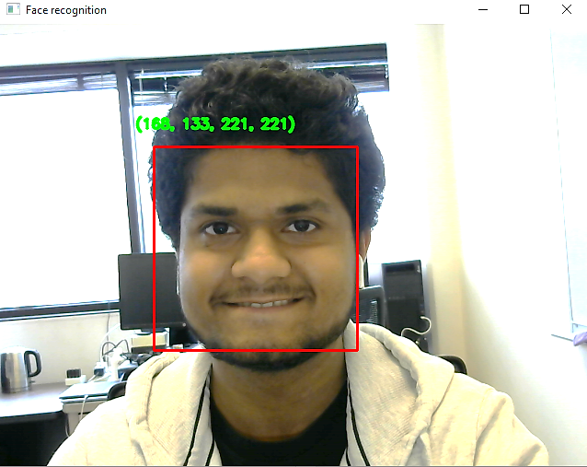
Running the Program
The program will detect the face in real-time
Rectangular bounding box will be drawn around the face
Face co-ordinates will be displayed on top-left side of the box

Slide 22
Debug
Errors are common when training cascade classifiers. Most of the time errors occur for one of two reasons:
Too many positive samples
Too few negative samples
If you are experiencing training errors:
Decrease the percentage of positive samples from 88 to 84 (or less)
Increase the number of negative samples by 100 to 200
Try experimenting with similar numbers

